Slide 1


Webmarkup
Lecture 4
[3 EC, 84 SBU , Product]
Location : Haarlem
Micha van der Meer (INF) , Frank Dersjant (IT)
Version 3.06
Notes:
company logo are respective owned by the company
Photo’s used are royalty free and under (CC0) license pixels.com
All other not mentioned graphics or text are © Witan BV
Questions ? Lecture material owner micha van der Meer

Slide 2

Course planning
Term 1 – 19/20 |  | Week
Lecture 1 | Introduction, Webmarkup setup | 36
Lecture 2 | Basic HTML | 37
Lecture 3 | Advanced HTML | 38
Lecture 4 | Basic CSS | 39
Lecture 5 | Advanced CSS | 40
Lecture 6 | Expert CSS + provision and explaining (end)assessment | 41
Lecture 7 | Webmarkup development tools | 42
Exam weeks | Finishing assessment | 44 – 45
10 November 2019 23:59 | Deadline assessment | 45
2

Slide 3
Questions about the previous lectures?
HTML 4.x vs 5.x structures
DOM
Grouse and Penguin are birds
Semantic markup
<header>, <section>, <nav>, <article> and <footers>
Forms
<legend>, <label>, <input> , post and get
Validation patterns
Color, date, email.
Strong vs bold
Italic vs emphasis
Favicons
Audio & Video
Validator
HTML 5 history
3

Slide 4

Quiz
5 min
CSS 3? | Right | Wrong
I. 360px <34em
II. selector
III. tomato
IV. color: #FF00HH;
V. <!– font size is 16 px -->
VI. style=“size:16px;"
VII. em
4
Notes:
Mobile (yes design, but no)
Selector prop & value
Predefined color
Not working -> Hex max FF
/* HTML comment not CSS */
Yes, but Inline is forbidden
em as unit

Slide 5

Questions about the Webmarkup expectation
Different questions about the student expectations
Advice:
Webmarkup is a 3 EC lecture (84 hours study load)
7 Lectures from 135 min approximately 16 Hours
Self-study = 84 – 16 = 68 hours
Training yourself : 6 hours a week.
Doing homework
Doing research
Installing and testing
Tryout different scenario’s
Being pro active!
End assignment : 4 days x 8 hours = 32 hours
5

Slide 6
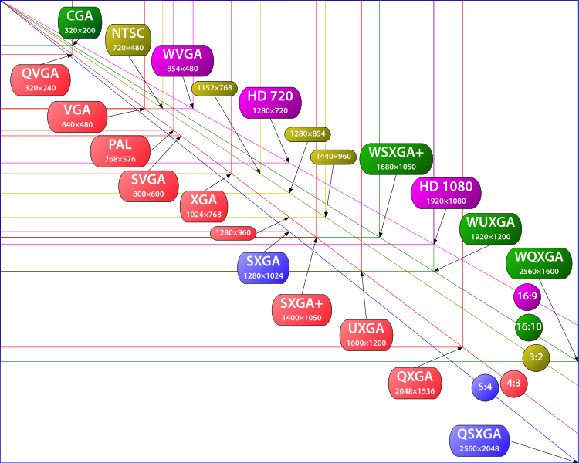
Overview design
35 standard resolutions with 7 different ratios
6
Notes:
http://forums.ubi.com/archive/index.php/t-595496.html
https://en.wikipedia.org/wiki/Ultra-high-definition_television

Slide 7
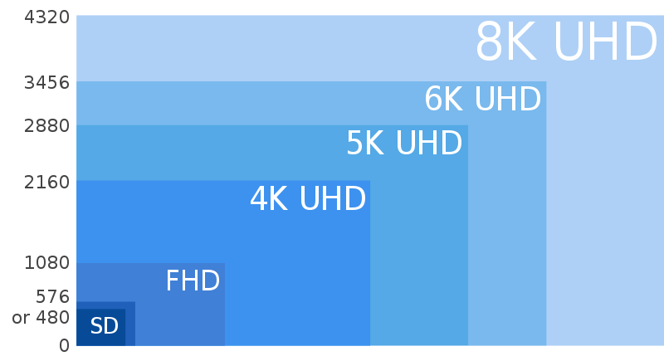
Overview design
HD generation resolution
7
Notes:
https://commons.wikimedia.org/wiki/File:8K_UHD,_4K_SHD,_FHD_and_SD.svg

Slide 8

Overview design
Euh… design department please tell me what todo
8

Slide 9

Overview design [What you can expect]
FIXED [f.e. 960px]
9

Slide 10

Overview design
FLUID [width = X%]
10

Slide 11

Overview design
ADAPTIVE [different fixed width version 960px, 720px, 360px etc..]
11

Slide 12

Overview design
RESPONSIVE [Content is changing depending the resolution, device, orientation]
12

Slide 13
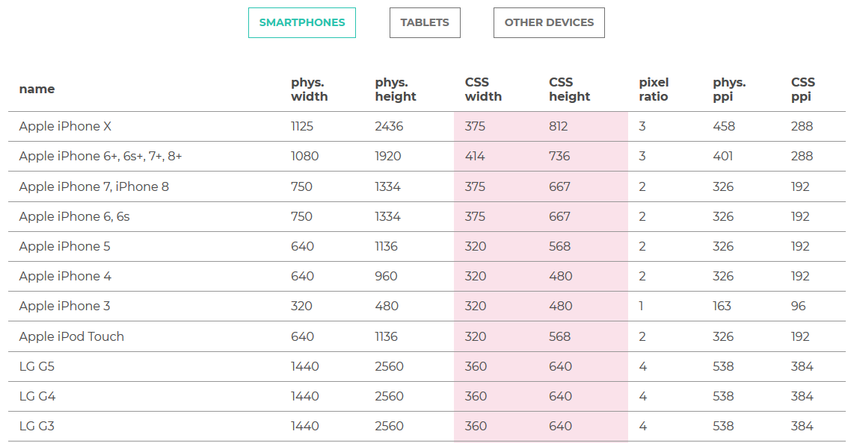
Overview design [Mobile 360px / 34em]
https://www.mydevice.io/#compare-devices
13
Notes:
Phys. With != CSS width
Blackberry Passport 1440 1440 504 504 3 453 274
Microsoft Lumia 1520 1080 1920 432 768 2.5 367 240
Apple iPhone 6+, 6s+, 7+, 8+ 1080 1920 414 736 3 401 288
Motorola Nexus 6 1440 2560 412 690 3.5 493 336
Samsung Galaxy Note 800 1280 400 640 2 285 192
Xiaomi Redmi Note 5 1080 2160 393 786 2.75 403 264
Blackberry Leap 720 1280 390 695 2 294 177
Blackberry Classic 720 720 390 390 1.8 294 177
LG Optimus G 768 1280 384 640 2 318 192
LG Nexus 4 768 1280 384 640 2 320 192
Blackberry Z10 768 1280 384 640 2 355 192
Apple iPhone X 1125 2436 375 812 3 458 288
Apple iPhone 7, iPhone 8 750 1334 375 667 2 326 192
Apple iPhone 6, 6s 750 1334 375 667 2 326 192

Slide 14
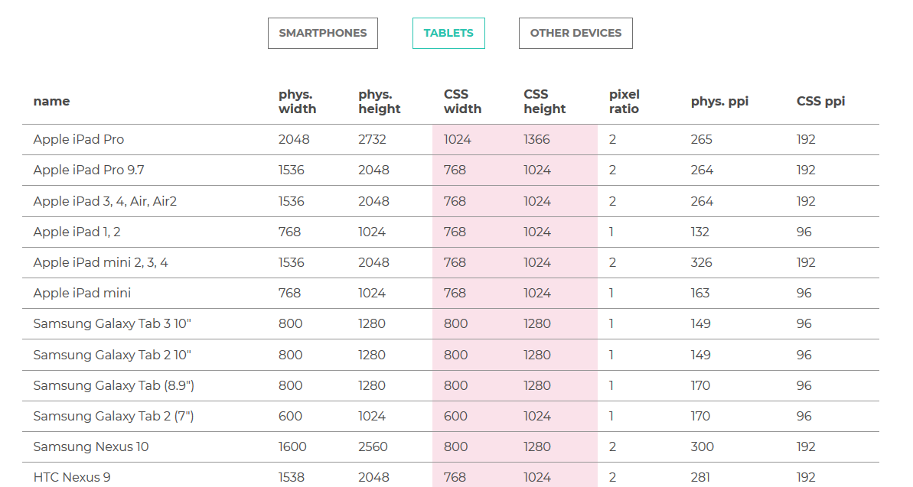
Overview design [Tablet 720px / 45em]
https://www.mydevice.io/#compare-devices
14
Notes:
Apple iPad Pro 2048 2732 1024 1366 2 265 192
Microsoft Surface Pro 3 1440 2160 1024 1440 1.5 / 1.4 216 144
Samsung Galaxy Tab 3 10" 800 1280 800 1280 1 149 96
Samsung Galaxy Tab 2 10" 800 1280 800 1280 1 149 96
Samsung Galaxy Tab (8.9") 800 1280 800 1280 1 170 96
Samsung Nexus 10 1600 2560 800 1280 2 300 192
Amazon Kindle Fire HD 8.9 1200 1920 800 1280 1.5 254 144

Slide 15
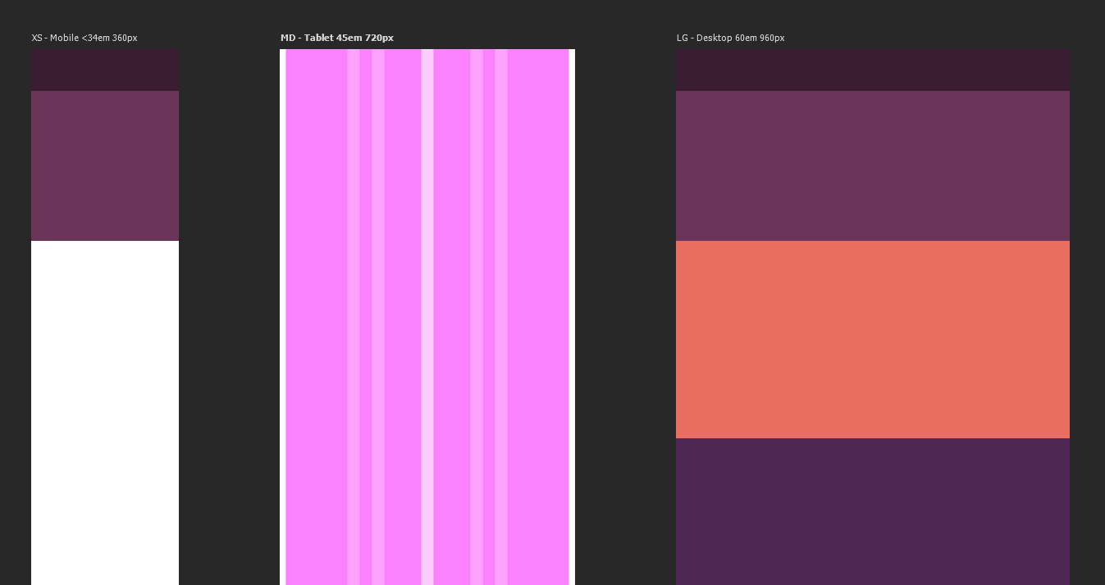
Overview design [Desktop 960px / 60em]
15
Notes:
960, 720 , 360 is the standard. But will change in the near future.
We talk about em (unit) later!

Slide 16

CSS – Cascade Style Sheet
What is CSS ?
16
Notes:
CSS is all about style, sizes, colors, margin, position etc… but also take care of your device…

Slide 17


CSS – Cascade Style Sheet
CSS – One-to-many relationship
index.html
stylesheet.css
haarlem.html
contact.html
17

Slide 18
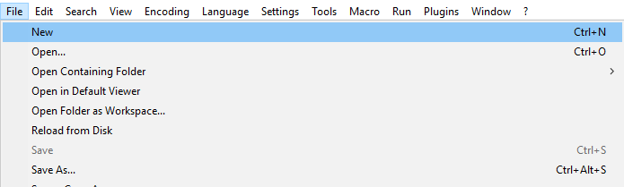
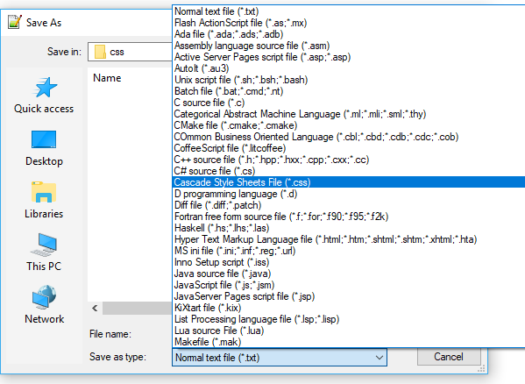
CSS – Cascade Style Sheet
Notepad++, create your own css
18

Slide 19
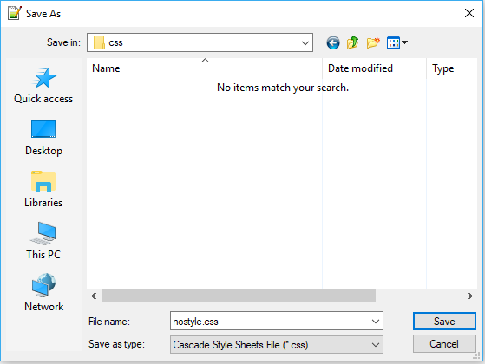
CSS – Cascade Style Sheet
Notepad++
19

Slide 20
CSS – Cascade Style Sheet
[.html]
<link
rel = “stylesheet“
type = “text/css“
href = “css/style.css“
/>
<link /> Tag for external file
rel Attribute to link external documents
stylesheet Attribute value
type Attribute type of the external document
text/css Attribute value
[Expects a US-ASCII, iso-8859-X file]
href Attribute for location of the external document
text/css Attribute value
[expects an URL]
20

Slide 21
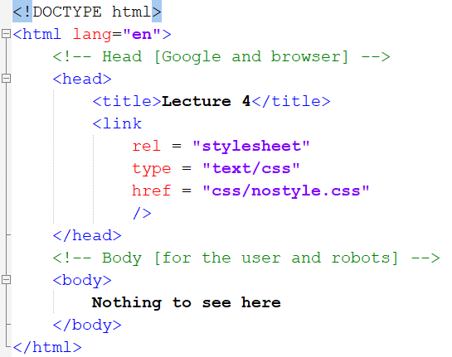
CSS – Cascade Style Sheet
[.html]
21

Slide 22

CSS – Cascade Style Sheet
[.css]
CSS rule structure:
selector
{
property: value;
}
22
Notes:
Property and value separated with a : (colon) And ending with a ; (semicolon)

Slide 23
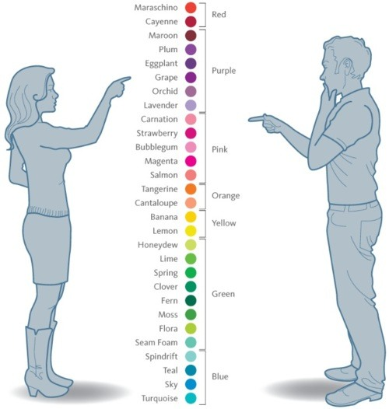
CSS – Cascade Style Sheet
CSS – Colors
23

Slide 24
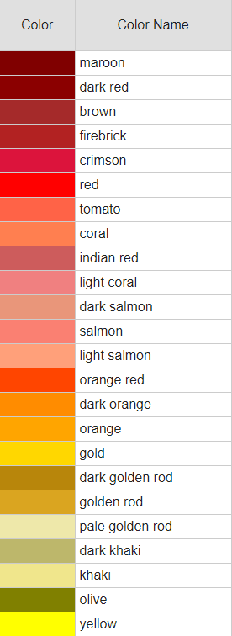
CSS – Cascade Style Sheet
CSS – Supports 140 predefined colors
24
Notes:
https://www.w3schools.com/colors/colors_names.asp

Slide 25
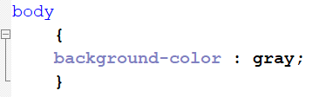

CSS – Cascade Style Sheet
[.css]
Colors
25
© Disney

Slide 26
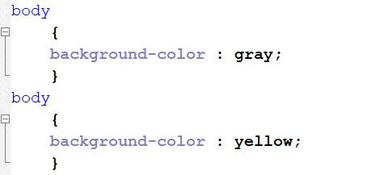
CSS – Cascade Style Sheet
[.css]
Colors
?
26

Slide 27

CSS – Cascade Style Sheet
[.css]
Colors
27
© Disney

Slide 28
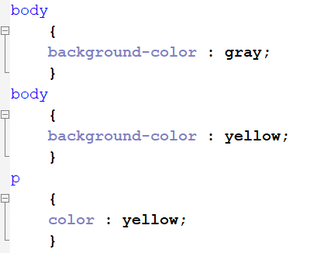

CSS – Cascade Style Sheet
[.css]
Colors
28
© Disney

Slide 29

Assignment lecture 4.1
10 min
Make a webpage with a header 1, header 2 and a <p> with lorum ipsum text.
Add an external link to a cascade stylesheet file
Add yellow to the background, red to <h1>, blue to <h2> and gray to the paragraph.
29
Notes:
Royalty free (CC0) license
Teacher guide : Min 30 – 35 (from 90 min)

Slide 30
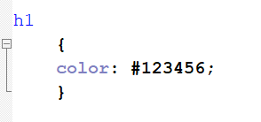
CSS – Cascade Style Sheet
[.css]
Colors
Decimal
10x10x10x10x10x10 =
10^6 = 1M different colors
30
Notes:
color : rgb (12, 34,56 );

Slide 31
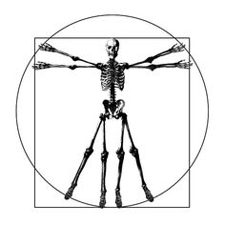
CSS – Cascade Style Sheet
Decimal
Why do we count in the DECIMAL format?
31

Slide 32


CSS – Cascade Style Sheet
Octal format
32
© Disney

Slide 33
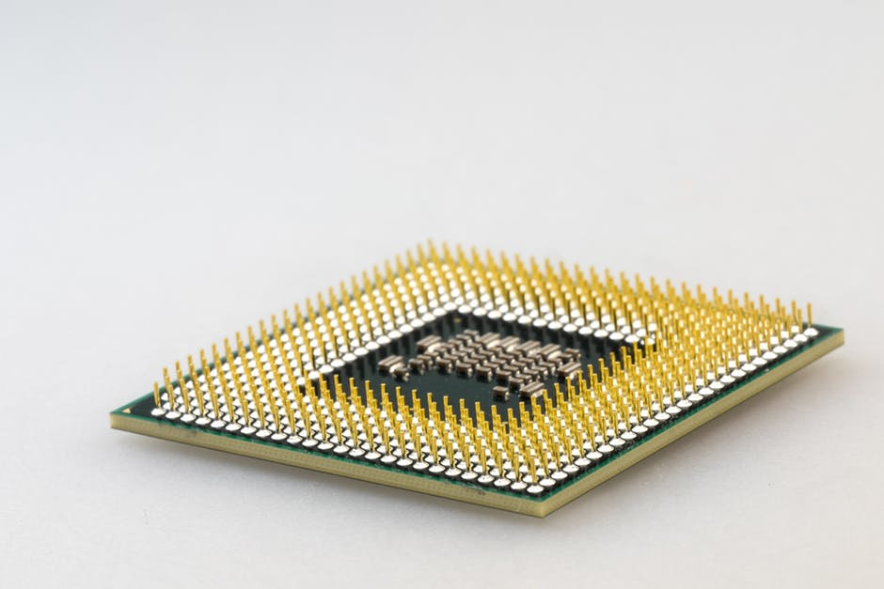


CSS – Cascade Style Sheet
Hexadecimal
?
…7,8,9,A,B,C,D,E,F and 10
33
Notes:
© Dnews

Slide 34
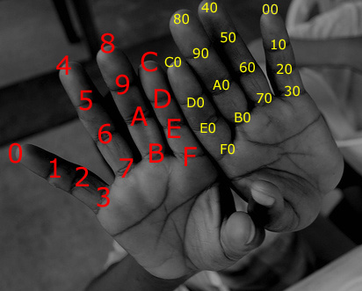
CSS – Cascade Style Sheet
Hexadecimal on your own hands
34
Notes:
© Dnews

Slide 35
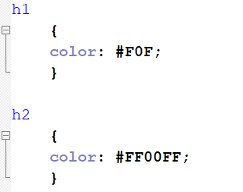
CSS – Cascade Style Sheet
[.css]
Colors [Hexadecimal]
Hexadecimal
16x16x16 =
16^3 = 4096 different colours.
Hexadecimal
16x16x16x16x16x16 =
256x256x256 =
4096x4096 =
16^6 = 16 M different colours.
35

Slide 36
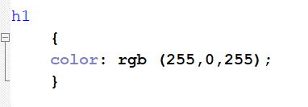
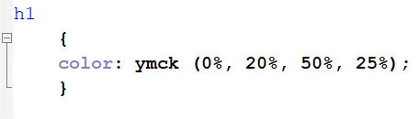
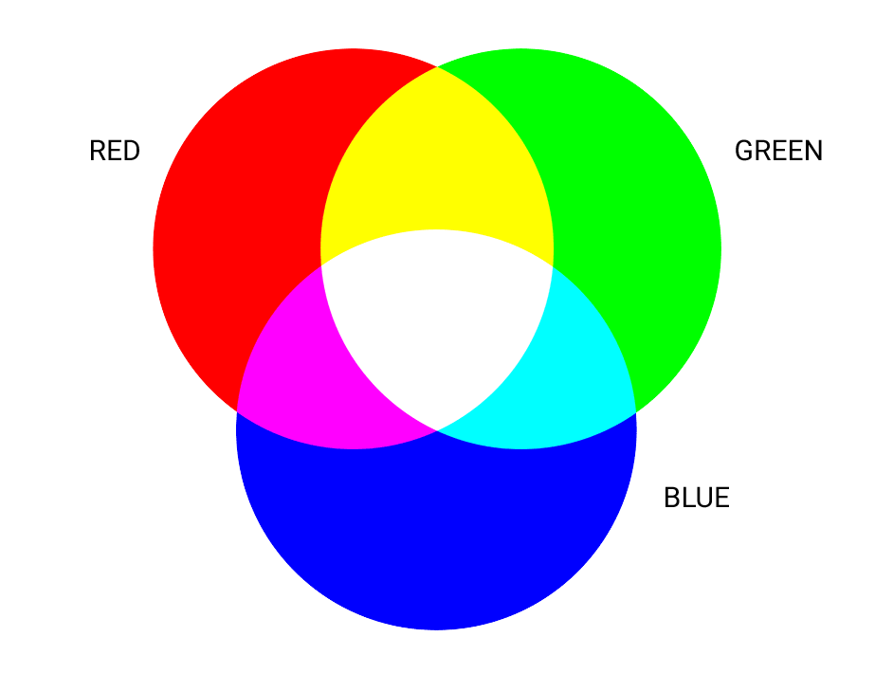


CSS – Cascade Style Sheet
[.css]
Additive (light) and Subtractive (paint) colors
36

Slide 37

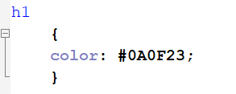
CSS – Cascade Style Sheet
[.css]
RGB Colors
Color: #0A0F23; -> Red #0A, Green #0F, Bleu #23
Hexadecimaal to decimal:
HEX 0, 1, 2, 3, 4, 5, 6, 7, 8, 9, A, B, C, D, E, F
DEC 0, 1, 2, 3, 4, 5, 6, 7, 8, 9, 10, 11, 12, 13, 14, 15
Hexadecimal #0A => 10 (decimal)
Hexadecimal #0F => 15 (decimal)
Hexadecimal #23 => 35 (decimal -> 2*16 + 3)
37

Slide 38
CSS – Cascade Style Sheet
[.css]
RGB Colors
Color: #0A0F23; -> Red #0A, Green #0F, Bleu #23
Hexadecimaal to decimal:
HEX 0, 1, 2, 3, 4, 5, 6, 7, 8, 9, A, B, C, D, E, F
DEC 0, 1, 2, 3, 4, 5, 6, 7, 8, 9, 10, 11, 12, 13, 14, 15
Hexadecimal #0A => 10 (decimal)
Hexadecimal #0F => 15 (decimal)
Hexadecimal #23 => 35 (decimal -> 2*16 + 3)
38

Slide 39
CSS – Cascade Style Sheet
[.css]
RGB Colors
Color: #0A0F23; -> Red #0A, Green #0F, Bleu #23
Hexadecimaal to decimal:
HEX 0, 1, 2, 3, 4, 5, 6, 7, 8, 9, A, B, C, D, E, F
DEC 0, 1, 2, 3, 4, 5, 6, 7, 8, 9, 10, 11, 12, 13, 14, 15
Hexadecimal #0A => 10 (decimal)
Hexadecimal #0F => 15 (decimal)
Hexadecimal #23 => 35 (decimal -> 2*16 + 3)
39

Slide 40
CSS – Cascade Style Sheet
[.css]
RGB Colors
Color: #0A0F23; -> Red #0A, Green #0F, Bleu #23
Hexadecimaal to decimal:
HEX 0, 1, 2, 3, 4, 5, 6, 7, 8, 9, A, B, C, D, E, F
DEC 0, 1, 2, 3, 4, 5, 6, 7, 8, 9, 10, 11, 12, 13, 14, 15
Hexadecimal #0A => 10 (decimal)
Hexadecimal #0F => 15 (decimal)
Hexadecimal #23 => 35 (decimal)
23 * (2^4) = 23 * (16) = 32
23 * (2^0) = 23 * (1) = 3
------- +
35
40

Slide 41
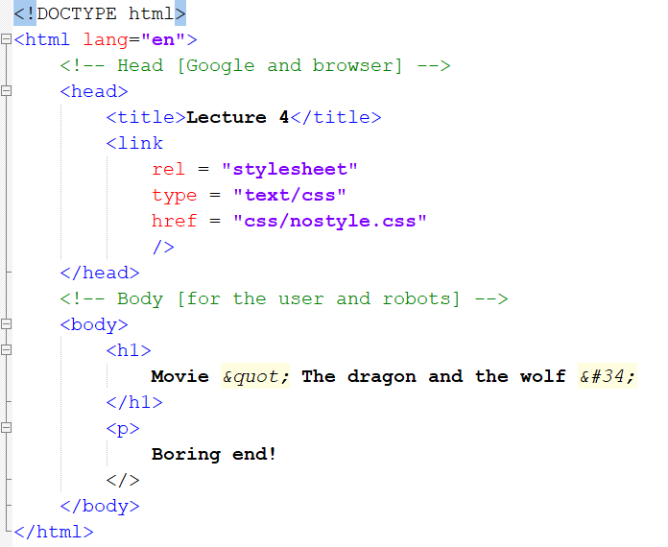
CSS – Syntax vs Logic error
[.html]
Syntax error
41

Slide 42
CSS – Syntax vs Logic error
Logic error
BLUE
SQUARE
42
Notes:
CSS !

Slide 43
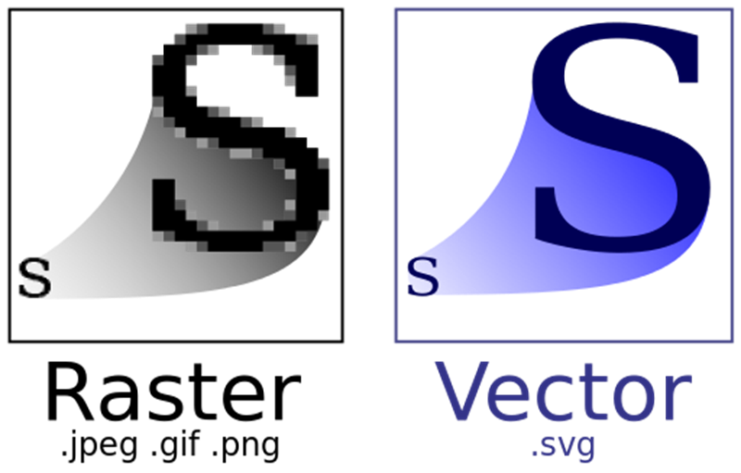
Scalable images
43

Slide 44
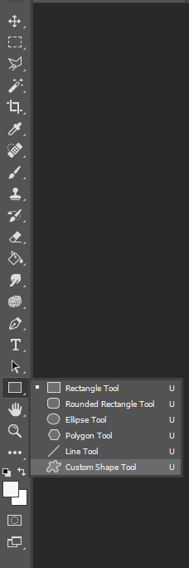
Create your own vector images
Photoshop
44

Slide 45
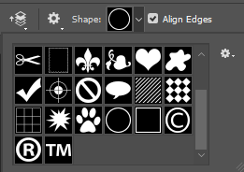
Create your own vector images
Photoshop
45

Slide 46
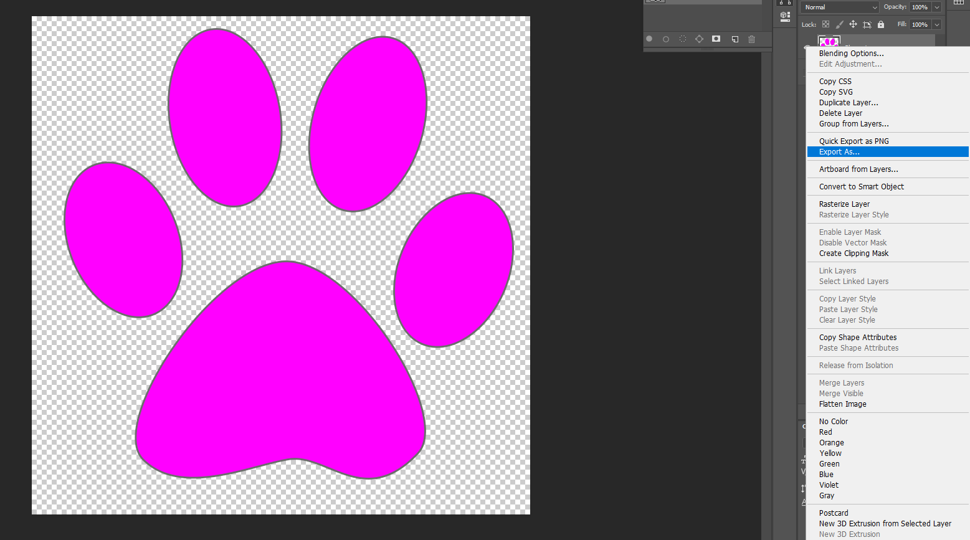
Create your own vector images
Photoshop
46

Slide 47
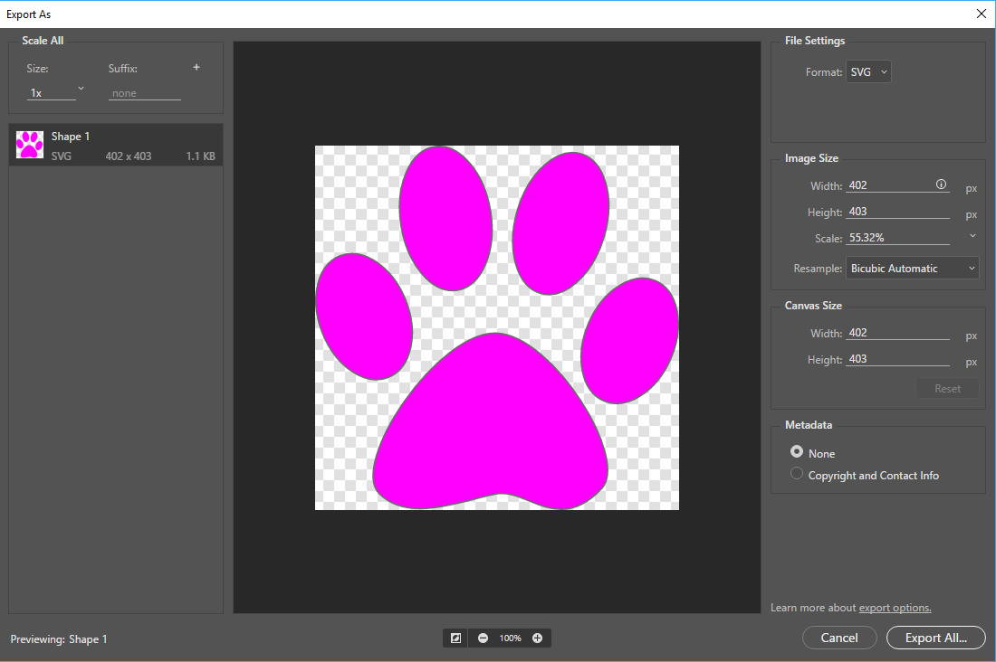
Create your own vector images
Photoshop
47

Slide 48
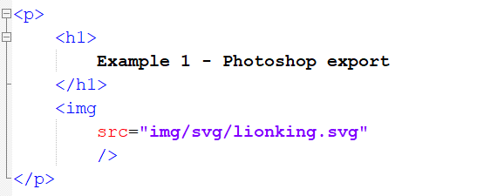
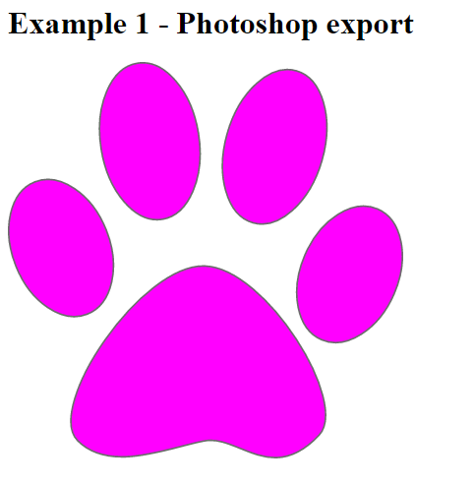
Create your own vector images
[.css]
48

Slide 49
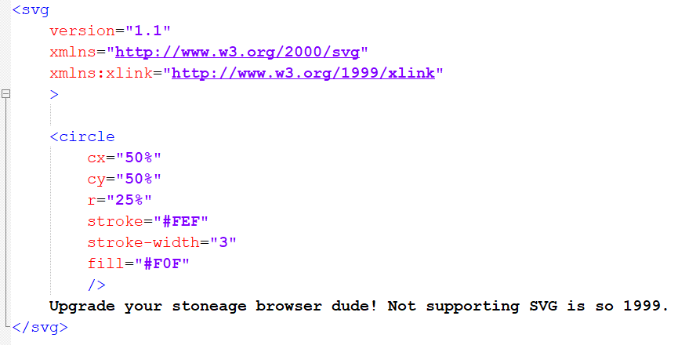
Create your own vector images
[.svg]
Code your own vector graphics
49

Slide 50
Create your own vector images
[.svg]
Code your own vector graphics
circle:
definition for a circle
cx and cy :
define x and y coordination’s
at the centre point.
r :
radius from the circle
stroke:
circle line colour #FEF.
stroke-width:
line width from the circle.
fill :
fills the circle with colour #F0F
50

Slide 51
Create your own vector images
[.svg]
Code your own vector graphics
circle:
definition for a circle
cx and cy :
define x and y coordination’s
at the centre point.
r :
radius from the circle
stroke:
circle line colour #FEF.
stroke-width:
line width from the circle.
fill :
fills the circle with colour #F0F
51

Slide 52
Create your own vector images
[.svg]
Code your own vector graphics
circle:
definition for a circle
cx and cy :
define x and y coordination’s
at the centre point.
r :
radius from the circle
stroke:
circle line colour #FEF.
stroke-width:
line width from the circle.
fill :
fills the circle with colour #F0F
52

Slide 53
Create your own vector images
[.svg]
Code your own vector graphics
circle:
definition for a circle
cx and cy :
define x and y coordination’s
at the centre point.
r :
radius from the circle
stroke:
circle line colour #FEF.
stroke-width:
line width from the circle.
fill :
fills the circle with colour #F0F
53

Slide 54
Create your own vector images
[.svg]
Code your own vector graphics
circle:
definition for a circle
cx and cy :
define x and y coordination’s
at the centre point.
r :
radius from the circle
stroke:
circle line colour #FEF.
stroke-width:
line width from the circle.
fill :
fills the circle with colour #F0F
54

Slide 55
Create your own vector images
[.svg]
Code your own vector graphics
circle:
definition for a circle
cx and cy :
define x and y coordination’s
at the centre point.
r :
radius from the circle
stroke:
circle line colour #FEF.
stroke-width:
line width from the circle.
fill :
fills the circle with colour #F0F
55

Slide 56
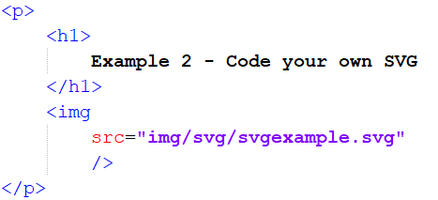
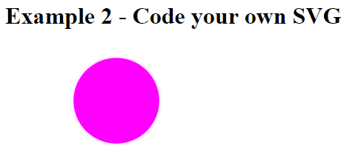
Create your own vector images
[.svg] & [html]
Code your own vector graphics
56

Slide 57
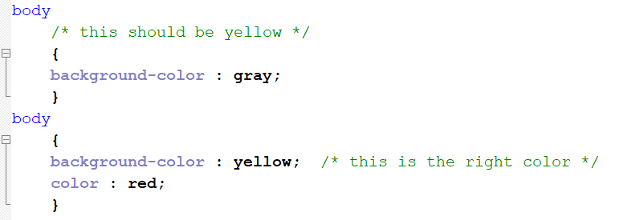
Comments in CSS
[.css]
CSS
57

Slide 58

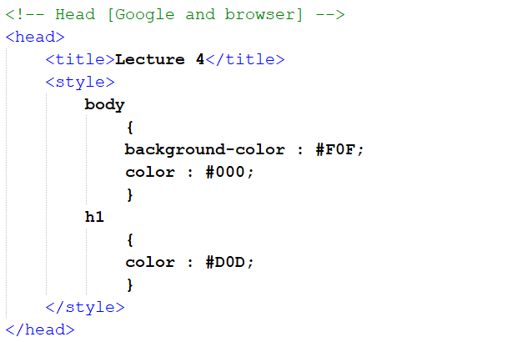
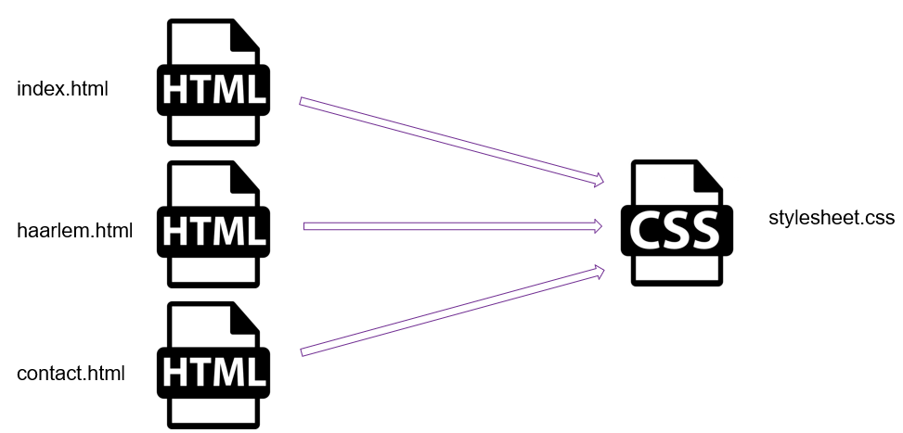

CSS in HMTL
[.html]
INTERNAL STYLE SHEET = FORBIDDEN
58

Slide 59
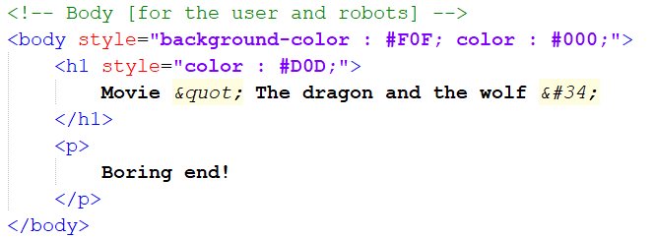
CSS in HMTL
[.html]
INLINE CSS = FORBIDDEN
59

Slide 60

CSS – Cascade Style Sheet
[.html]
External .css is the only way!
The “stylesheet” is a general style setup for
all HTML pages!
60

Slide 61


Inheritance
Have wings
Have legs
Have beak
REMEMBER?
Bird
Grouse
Penguin
Can fly
Can swim
61

Slide 62
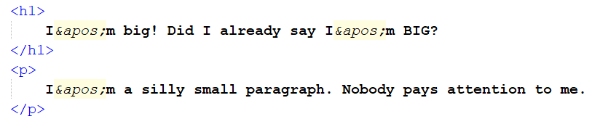
Inheritance
[.html]
Expectations
62

Slide 63

Inheritance
[.html]
Expectations (this is what you expect)
63

Slide 64
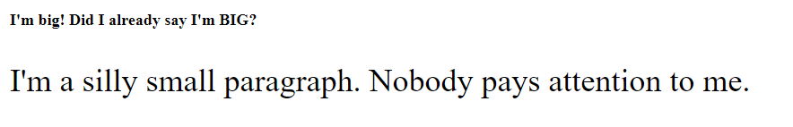
Inheritance
[.html]
Expectations (this is what you get)
?
64

Slide 65
Inheritance
[.html]
Expectations
BLUE
SQUARE
65
Notes:
Feels like a blue square

Slide 66
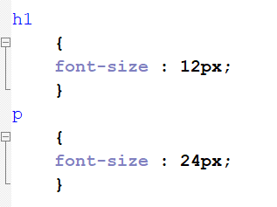
Inheritance
[.html] & [.css]
Expectations
BLUE
SQUARE
66
Notes:
So you can change the size with -> font-size

Slide 67
CSS vs HTML
[.html][.css]
EM [emphasis]
.HTML
REMEMBER?
“<em>” element
<em> html text </em>
67

Slide 68
CSS vs HTML
[.html][.css]
EM [emphasis]
.HTML
.CSS
“<em>” element
“em” unit
<em> html text </em>
H1 {width: 10em};
68

Slide 69
CSS vs HTML
[.css]
EM [emphasis]
In CSS, an em unit is equal to the computed font-size
for the element to which the em is applied.
! If no font size is defined anywhere in the CSS,
the em unit will be equal to the browser's default
font size for the document, which is usually 16px.
69

Slide 70
CSS vs HTML
[.css]
EM [emphasis]
In CSS, an em unit is equal to the computed font-size
for the element to which the em is applied.
! If no font size is defined anywhere in the CSS,
the em unit will be equal to the browser's default
font size for the document, which is usually 16px.
70

Slide 71

CSS vs HTML
[.css]
EM [emphasis]
In CSS, an em unit is equal to the computed font-size
for the element to which the em is applied.
! If no font size is defined anywhere in the CSS,
the em unit will be equal to the browser's default
font size for the document, which is usually 16px.
65+ = 200%
71

Slide 72
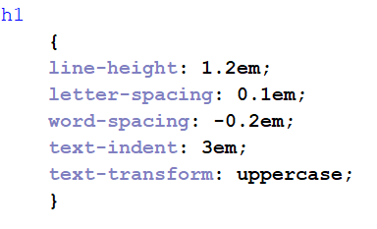
CSS vs HTML
[.css]
EM [emphasis]
Text 1
Text 2
72

Slide 73
CSS vs HTML
[.css]
EM [emphasis]
T e x t 1
T e x t 2
73

Slide 74
CSS vs HTML
[.css]
EM [emphasis]
Text 1, Text 2
74

Slide 75
CSS vs HTML
[.css]
EM [emphasis]
T e x t 1
T e x t 2
75

Slide 76
CSS vs HTML
[.css]
EM [emphasis]
capitalize
uppercase
lowercase
none (default value)
76

Slide 77

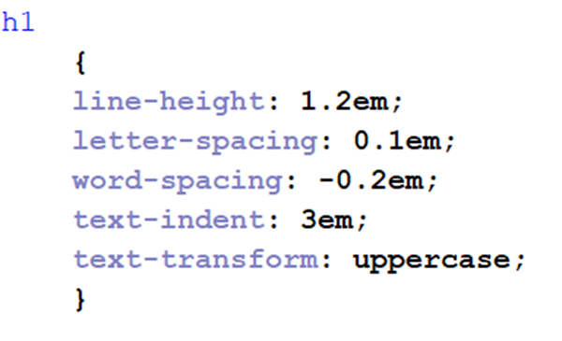

CSS vs HTML
[.css]
EM [emphasis]
77

Slide 78
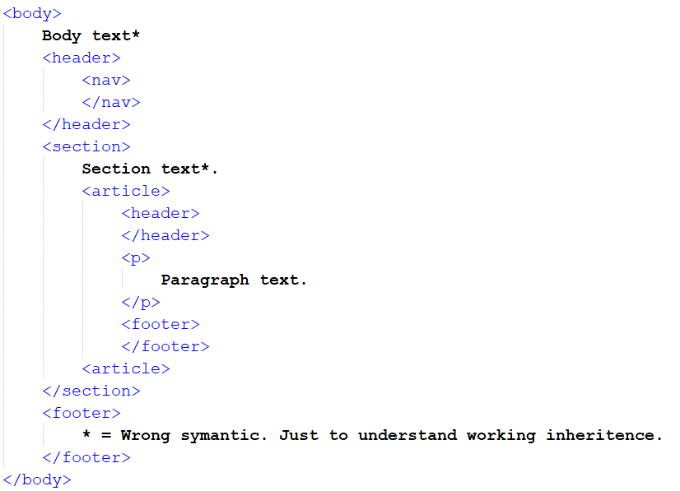
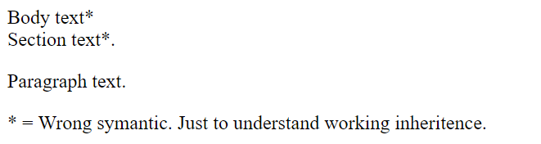
Inheritance
[.html]
78

Slide 79
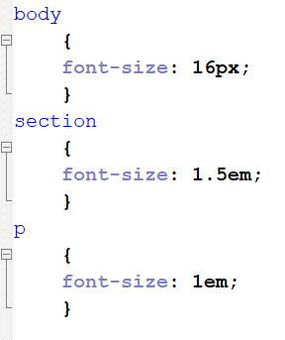
Calculate the size in px and em for <p>
[.html] & [.css]
1 min
79
Notes:
60 min

Slide 80
Inheritance
[.html] & [.css]
body = 16px
16px
80

Slide 81
Inheritance
[.html] & [.css]
body = 16px
section = 1,5em * body = 1,5 * 16 px = 24px
16px
24px
81

Slide 82
Inheritance
[.html] & [.css]
body = 16px
section = 1,5em * body = 1,5 * 16 px = 24px
16px
24px
24px
82

Slide 83
Inheritance
[.html] & [.css]
body = 16px
section = 1,5em * body = 1,5 * 16 px = 24px
16px
24px
p = 1.0em * article (section) = 1 * 24 px = 24 px
24px
24px
83

Slide 84
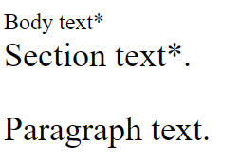
Inheritance
[.html] & [.css]
body = 16px
section = 1,5em * body = 1,5 * 16 px = 24px
16px
24px
p = 1.0em * article (section) = 1 * 24 px = 24 px
24px
24px
16px / 1em
24px / 1.5em
24px / 1em
84

Slide 85

Fonts
85

Slide 86
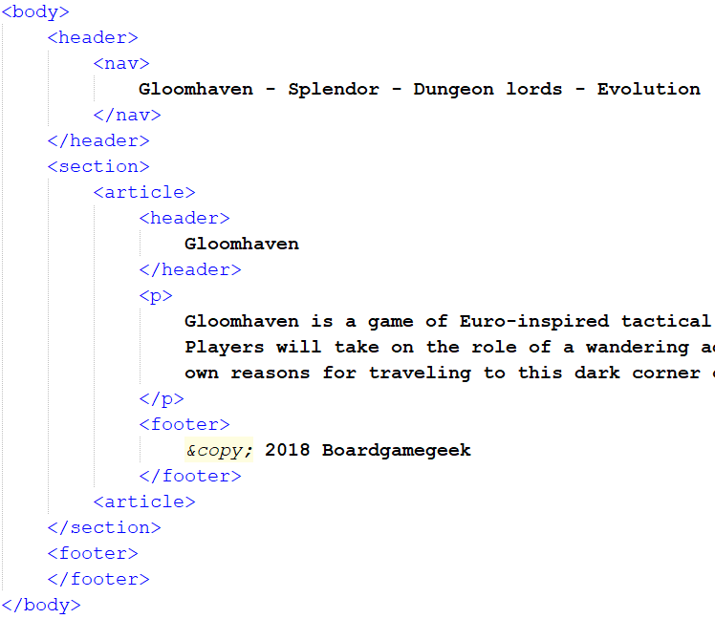
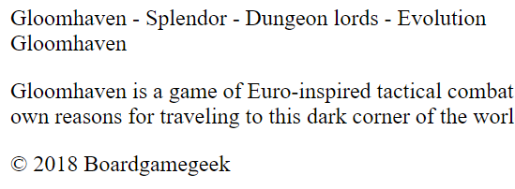
Fonts
[.html]
86

Slide 87
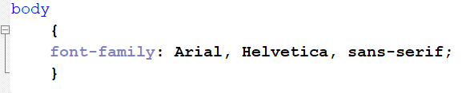

Font family
[.html][.css]
87

Slide 88


Font family
[.html][.css]
88

Slide 89
Font family
[.html][.css]
89

Slide 90

Google fonts
https://fonts.google.com/
90

Slide 91

Google fonts
https://fonts.google.com/
91

Slide 92

Google fonts
https://fonts.google.com/
92
Notes:
DO not use the standard code!!

Slide 93
Google fonts
https://fonts.google.com/
93
Notes:
Otherwise you have to copy this line to every .html file who is using this font!

Slide 94


Google fonts
[.css]
https://fonts.google.com/
94
Notes:
DO NOT COPY STYLE !!

Slide 95

Google fonts
[.css]
95
Notes:
DO NOT COPY STYLE !!

Slide 96



Create your own font
[.css]
96
Notes:
Embedded OpenType (EOT)
WOFF 2.0 - Web Open Font Format

Slide 97

CSS validation
[.css]
http://jigsaw.w3.org/css-validator
97

Slide 98

CSS validation
[.css]
http://jigsaw.w3.org/css-validator
98

Slide 99
CSS validation
[.css]
http://jigsaw.w3.org/css-validator
Tip from W3C! ☹
(close the img tag with > instead of /> if using HTML <= 4.01)
99

Slide 100
Assignment lecture 4.2
Create article with a header, paragraph and a footer.
Header; font family “Courier New”,”Lucida Console” , size 32px, red (in hexadecimal), font style is oblique.
Paragraph; font family “Cedarville Cursive” (Google) , size 10vw, blue (in decimal), font variant is small caps.
Footer; font family “Ostrich sans master” (download from Moodle), size 1.6vw, pink (HSLA), font stretch is expanded.
Validate the webpage HTML & CSS
30 min
100
Notes:
Royalty free (CC0) license
Teacher guide : Min 30 – 35 (from 90 min)

Slide 101

Resume lecture
Question about the student expectations
Resolutions
Design mobile first
CSS selector {prop : value;}
CSS color
Hex & Dec
Syntax and Logic errors
Vector graphics
CSS Comment
Internal and Inline Stylesheet (Forbidden)
EM [emphasis](CSS & HTML)
EM PROPS (line-height, letter spacing etc..)
EM inheritance
Fonts
CSS validation
101
Notes:
(CC0) license

Slide 102

Next week…
Box model [margin, borders and Padding]
Trouble
vertical margin collapse
id & class
Element selecting [comma, space, bigger sign, plus, tilde (wave), no space]
Hulk and Pink panther
Pseudo class [link, visited, hover, active]
Pseudo class [nth-child -> odd, even, xn+y]
Specificity calculations [id, class, (pseudo)-elements]
!important
fixed content with a scalable background
Meaningful programming
102
Notes:
(CC0) license

Slide 103

Questions
103
Notes:
(CC0) license

Slide 104

Homework
104
Notes:
(CC0) license

